Slide 1
Answering to the needs of internally displaced people during a war in Ukraine.
Pavlo Kolesnyk MD PhD
FM Department of Uzhgorod National University
International volunteer clinic “InterFamily”
Uzhgorod, Ukraine
March 2023

Slide 2
War in Ukraine: - affected health care system
1,206 ruined medical facilities, 171 of them cannot be restored…
National resources have been redirected to the military service…
Pharmacy shortage in the beginning of the war, needs in life-saving meds
Huge demand for free medical service among IDPs

Slide 3
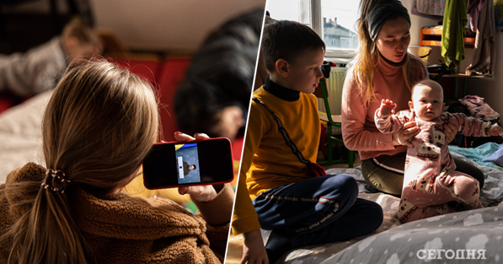
War in Ukraine: our ambitious tasks
To provide medical help for IDPs : high quality family medical care (acute and chronic disease care, clinical diagnosis, treatment, providing life-saving meds etc.)
To help IDPs to stay healthy: prevention, screening, chronic disease management, prevention of over-diagnostics and medicalisation
To revitalize practical med. education: give medical students and residents opportunity to learn in the FDs practice

Slide 4
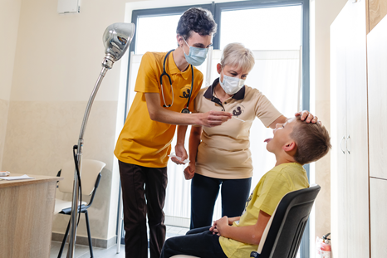
Practical medical education at the “InterFamily” clinic
Doctor-assistant training system: "ABC residency training in practice”, “the three pair eyes” rule
1
Participation of residents in all fields of the clinic work:
reception,
office,
home visits,
laboratory,
free pharmacy,
e-system
2

Slide 5
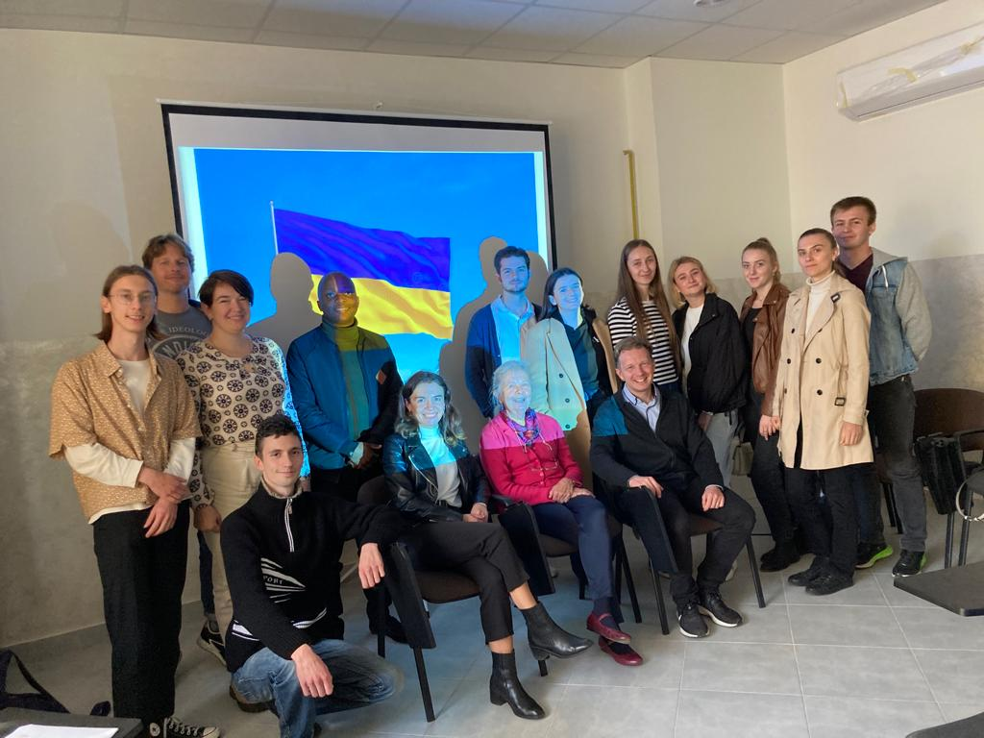
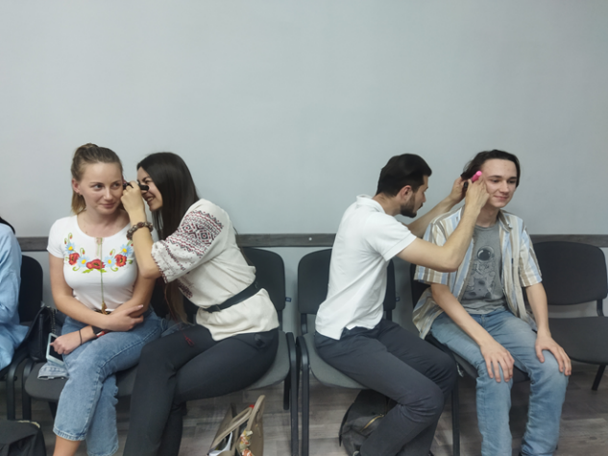
Continuous medical education at the “InterFamily” clinic
3
Implementation of EUSIT-PEP Project ( training the patients and IDPs in health care ) using residents\students volunteers
Implementation of the Project “EUSIT” (supporting Ukrainian GPs and GP trainees in their online training)
4
International experts visits : exchanging knowledge (lectures and practice work )
You are welcome!
5

Slide 6
During 47 weeks there 4223 have applied to our medical center.
56% of patients told they have already been to the center.
So this was not their first visit.

Slide 7
Gender and age distribution of our patients
71% of patients are female,
29% are male 50% of the patients are 50+ y.o.

Slide 8
Age distribution of our patients

Slide 9
Geography of our patients

Slide 10
The top leading medical reasons and diagnosis why IDPs’ applied to the clinic (coding of the diagnosis in ICPC-2 )
Respiratory diseases (23%)
Cardiovascular diseases (21%)
Bones and skeleton diseases (10%)
Neurological diseases
Skin diseases

Slide 11
Mental health care in the “InterFamily” clinic

Slide 12
THE FREQUENCY OF DEPRESSION AMONG INTERNALLY DISPLACED PATIENTS APPEALS TO UZHGOROD “INTERFAMILY” CLINIC IN UKRAINE
Study design:
Results of our study
Statistical analysis of the reasons for appeals and diagnoses including depression coded according to ICPC-2
Internal database of 3371 IDP patients, coded by ICPC-2 was analyzed
89 randomly selected patients were anonymously screened for depressive disorder using the PHQ-9
Calculation gave an opportunity to evaluate severe/moderate/absence of depression
Only 102 out of 3371 codes belong to P (psychological) group, which is 3% of the total amount.
Among 89 registered anonymous responses:
severe depression (>20 points) occurred in 6(6.74%)cases,
moderate depression (14-19 points) – in 20(22.47%), (10-14 points) – in 22(24.72%),
mild depression (5-9 points) – in 32(35.95%),
absence of depression (0-4 points) – only in 9 cases(10.11%).

Slide 13
Prevention and screening - research aim in the “InterFamily” clinic

Slide 14
ARE FAMILY DOCTORS AND INTERNALLY DISPLACED PATIENTS STILL CONCERNED IN SCREENING DURING WAR?
Thousands IDPs lost family doctors and remained without constant medical help
The main reasons for which IDPs appeal to medical help to the clinic - treatment and primary care for existing diseases but not prevention
Frequency of CVD screening and oncological disease screening among FDs and patients during war
657 cases of IDP women 18-39y.o. were analyzed
Only 4.5% of IDP women in the age of 40-74 years who appealed to the clinic were screened for breast cancer
Insufficient concern of FDs about screening
Screening and early detection of oncological diseases are not a priority and are often underestimated by patients

Slide 15
“Screening advisor” – and easy way to solve the problem with screening of NCDs
No state supported screening program in Ukraine.
Project in “U-Screen” was stared 10 years ago.
Database about the most frequent screening collected from EURACT national council members from 30 European countries
USPTFS and NICE screening programs were considered
Web-based program “Screening advisor” has been designed by our department
“Screening advisor” web-based tool is going to be implemented in the practical routine of “InterFamily” clinic

Slide 16
The future of the “InterFamily” Clinic :
Aiming for self-financing
How to show solidarity with Ukraine :
Talk about us
If possible - raise more money
Come and visit us!
My gratitude for your help!!!!
For donations in EURO please use this information: Name: HABOR PETRO Bank Address: 4800 Vasarosnameny, Szabadsag square 33. Address of Recipient: 90202 BEREGOVE B.HMELNICKIY STR. 10/A UKRAINE IBAN: HU63 1177 5441 2884 8886 0000 0000 SWIFT: OTPVHUHB Phone number: +380955772240 E-mail:gabor.peter1954@gmail.com Purpose: Refugees in Uzhgorod, Pavlo Kolesnyk

Slide 17
3—min. Video: “Welcome to “INTERFAMILY” CLINIC”
https://youtu.be/h_eZsBY5URg

